Slide 1
COMMUNITY LIBRARY MANAGEMENT SYSTEM
Team No -1
Student Name : I. Deekshitha Roll No: 2620040021
Student Name : S . Kavya Roll No: 2620040022

Slide 2
Abstract
The Community Library Management System on Campus is a Java-based application designed to simplify library operations by replacing manual record keeping with an organized and efficient system. It helps manage books, student details, book searches, issuing and returning books, and borrowing records.
The system uses Java concepts such as classes, objects, methods, loops, conditional statements, arrays or collections, and exception handling. It reduces paperwork, minimizes errors, saves time, and improves book availability tracking.
Overall, the system makes library management easier for students and administrators. It can be further improved by adding database connectivity, user authentication, fine calculation, notifications, and online book reservations.

Slide 3
Understanding Problem Statement
Community libraries need to manage book records, member details, and borrowing activity. Manual record-keeping can make it difficult to find books, check availability, and track loans and returns. Our Java system helps organize these library tasks in one place.

Slide 4
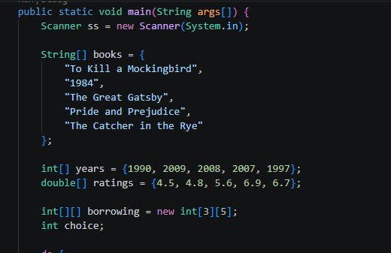
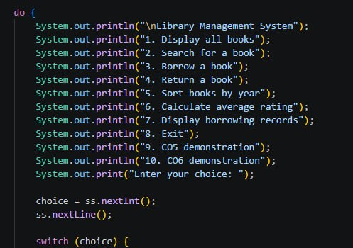
CO 1 – JAVA FOUNDATIONS
Our project applies Java basics through its program structure and library menu. It uses primitive data types, variables, constants, operators, and arrays to store and process book information. Scanner accepts user input, while printf formats output. The program uses if/else, switch, loops, break, and a 2D array to manage borrowing records.

Slide 5
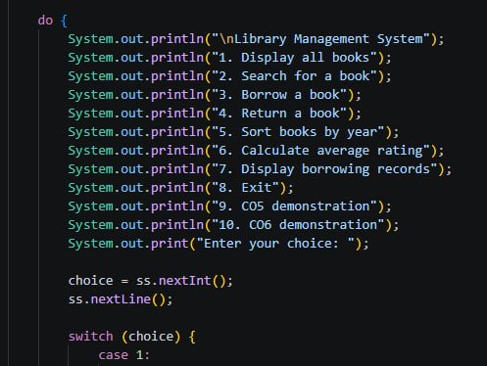
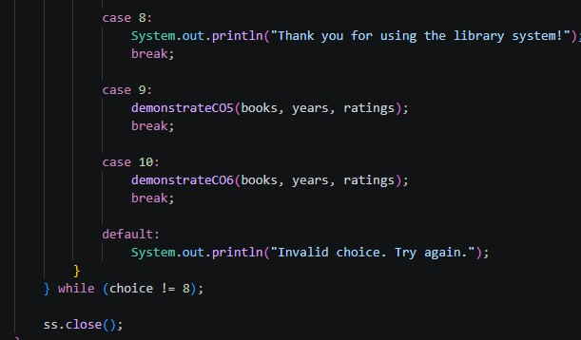
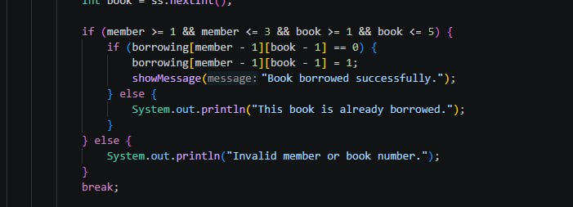
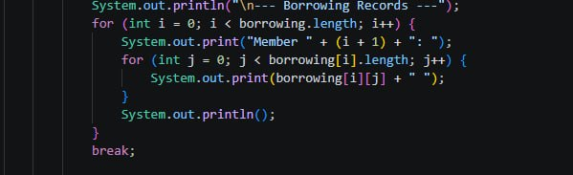
CO 2 – CONTROL FLOW
Our project uses control flow to run the library menu and handle each user choice. A do-while loop repeats the menu until the user exits. switch-case selects the requested operation, while if/else checks input and borrowing status. for and nested for loops process book and borrowing records, and break and default handle menu cases and invalid choices.
Do-while menu and switch case
If/else
For and nested for loops

Slide 6
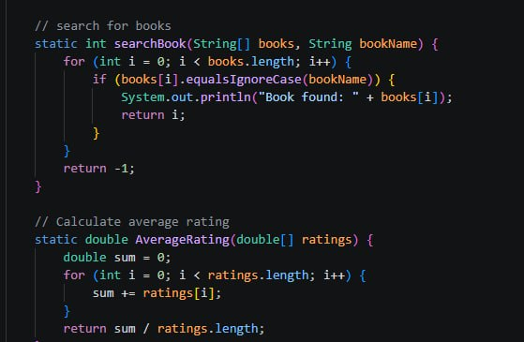
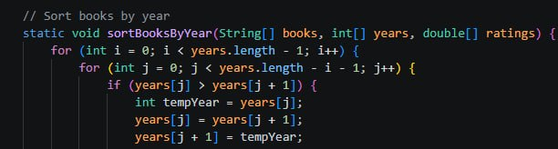
CO 3 – Methods, Searching, Sorting and Arrays
Our project uses methods to organize library tasks. Methods accept parameters and return results; for example, searchBook() searches for a title and returns its position. The overloaded showMessage() methods display messages in different ways. The project also traverses arrays, sorts books by year, and uses nested loops to display the 2D borrowing records.

Slide 7
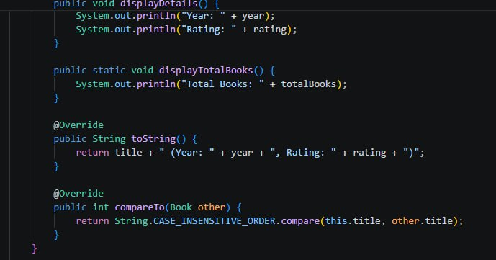
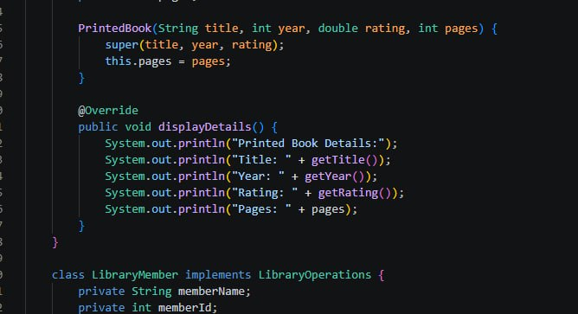
CO 4-Object- Oriented Programming
Our project demonstrates object-oriented programming through the Book class and its objects. It uses private fields with getters and setters for encapsulation, constructors to initialize book details, and inheritance through EBook and PrintedBook, which extend Book. The subclasses override displayDetails(), while the LibraryOperations interface defines borrowing and returning operations.

Slide 8
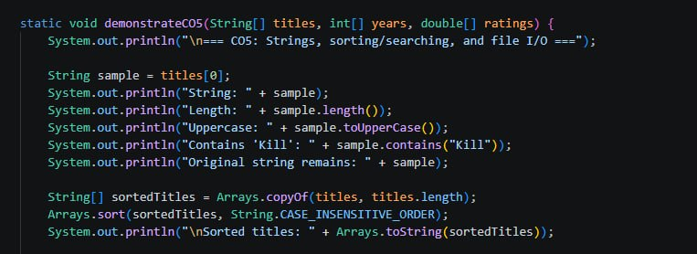
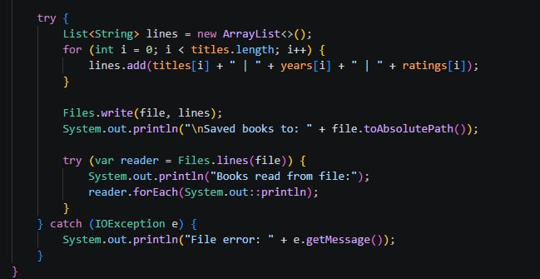
CO 5-Strings, Searching, Sorting and File handling
Our project demonstrates string operations by checking a book title’s length, converting it to uppercase, and searching within it. It sorts and searches book titles using arrays and collections. It also saves book details to a text file and reads them back using Java file handling.

Slide 9
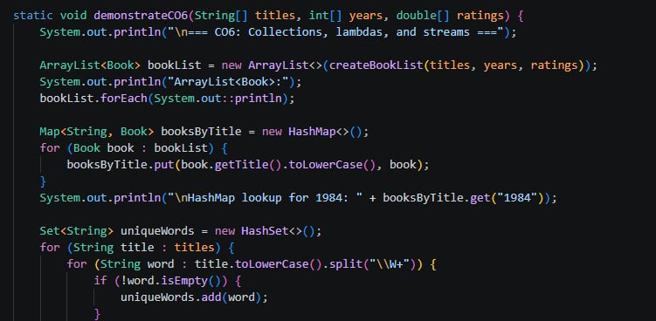
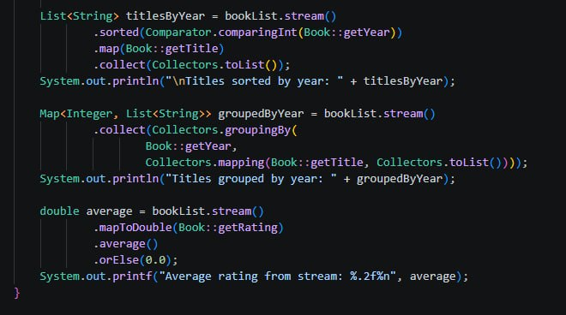
CO 6-Collections and Streams
Our project uses ArrayList, HashMap, and HashSet to store and organize book data. It uses collections to look up books and keep unique words from book titles. It also processes book records to filter, sort, group, and calculate average ratings.

Slide 10
Conclusion
The Community Library Management System organizes book information and supports common tasks such as displaying, searching, sorting, borrowing, and returning books. Through the project, we applied Java fundamentals, control flow, methods, arrays, object-oriented programming, file handling, and collections. The project demonstrates how these concepts can be combined to build a simple library program.

Slide 11
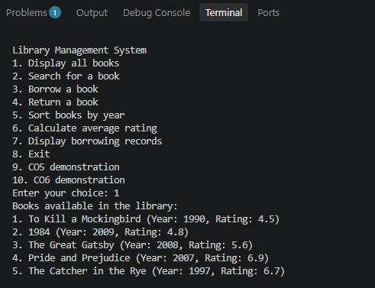
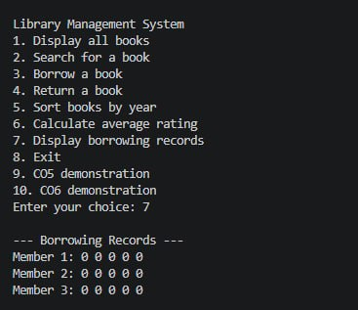
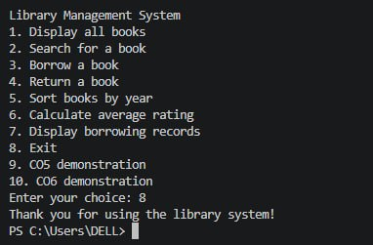
OUTPUTS -

Slide 12
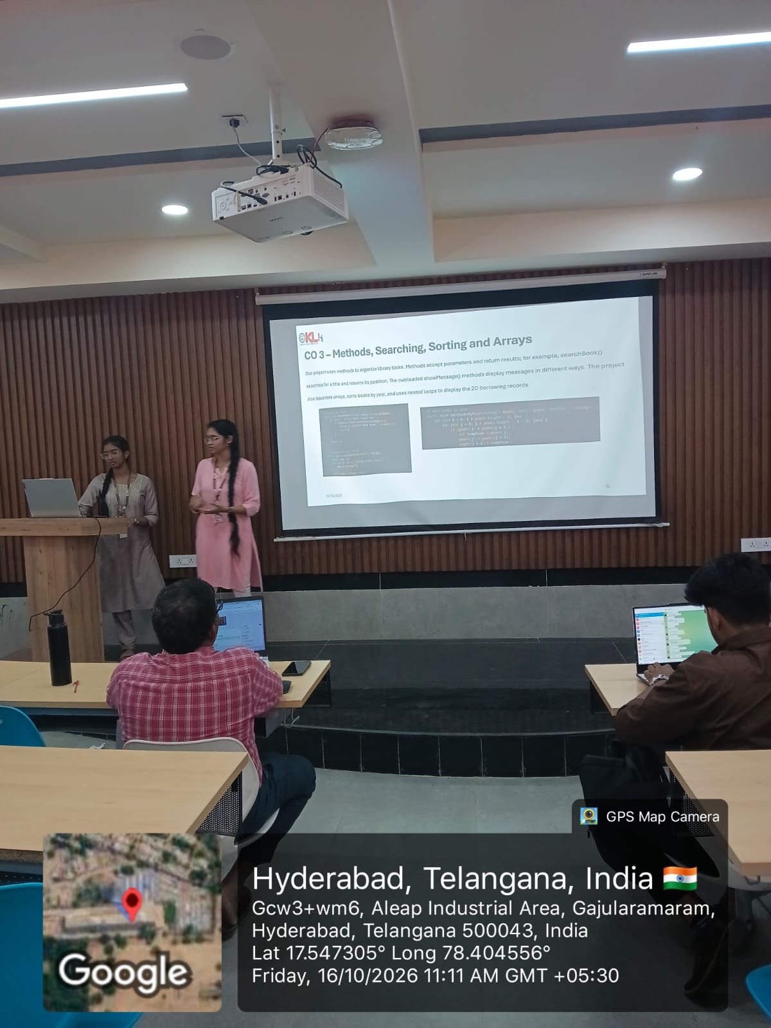
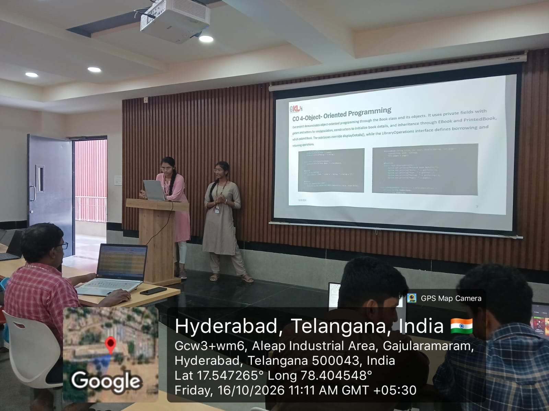
Geo Tag Photo-
Git hub link -
https://github.com/deekshitha0897/Community-Library-Management-System

Slide 13
THANK YOU

